Slide 1
Eating Chinese Food
What to eat and how to order food and drinks in a restaurant?

Slide 2
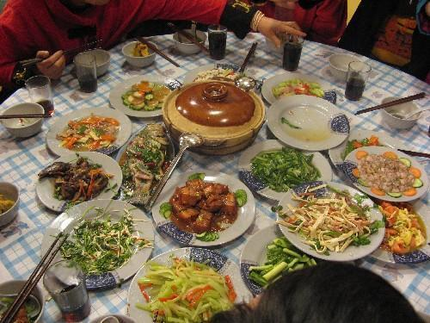
What do you see?

Slide 3
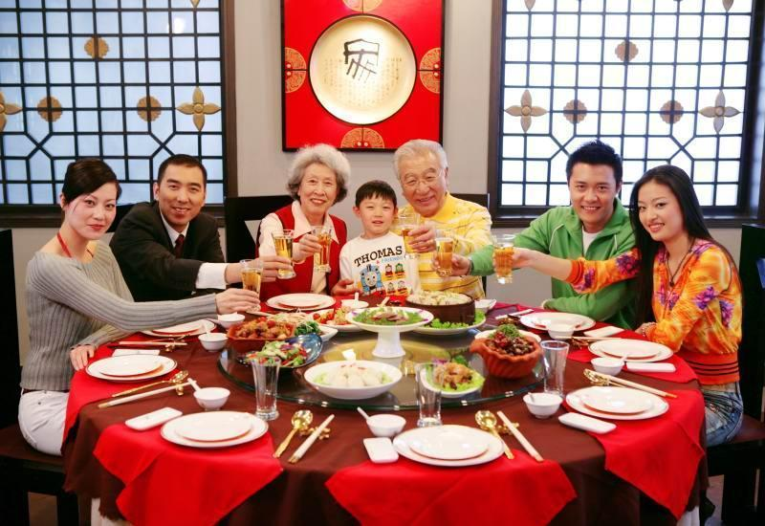
What do they do?

Slide 4
Watch the video clips then discuss in groups of 3 and fill in the first and second columns of the KWL worksheet.
http://www.youtube.com/watch?v=pd0-oKRnwVw&feature=relmfu
http://www.youtube.com/watch?v=9RKhp71XF-s

Slide 5
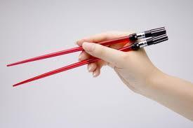
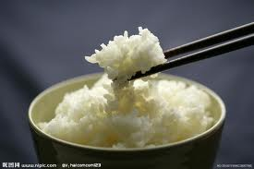
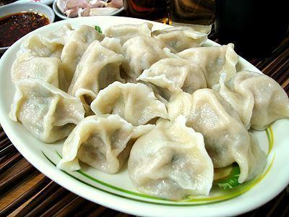
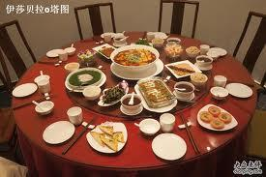
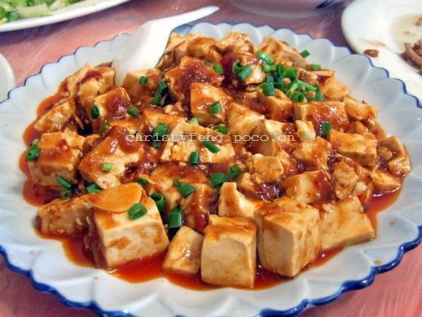
Identify the items you may have learned from the lesson today – fill in the last column of KWL worksheet.

Slide 6
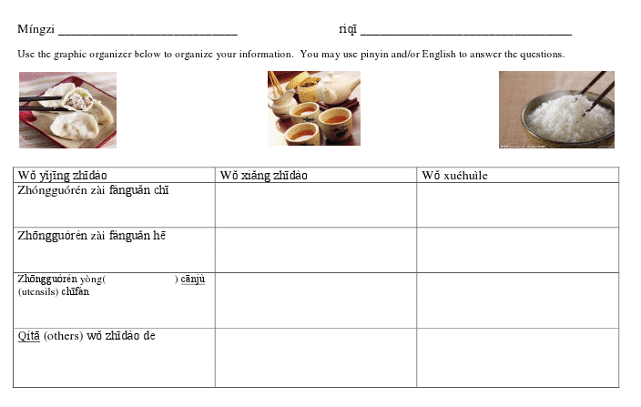
KWL worksheet

